Slide 1
Intro to Python
with Tracy the Turtle
Notes:
Hi, and welcome to your first lesson with Python! In this video, we’re going to learn who Tracy the Turtle is and use some commands to write our first code! Let’s get started!

Slide 2

Who is Tracy?
Here’s Tracy!
Tracy is a turtle that will follow commands we give her when written in Python
Notes:
So who is this Tracy character? Tracy is a turtle that will follow our commands if we tell them to her in the language she understands. For example, you might have a pet dog that understands that when you say ‘Speak’, it means to bark. If you used a different word with your dog, like ‘bark’ or ‘talk’, it may not know what you mean because you didn’t use the word they know.
Tracy is the same way. She only understands commands you give her that are written in a language called ‘Python.’ Traditional English is not a language she understands, the same way that if someone asked you where the bathroom was in Swahili, you may not be able to understand their question.
In order to communicate with Tracy, we need to learn her language which is Python! Let’s take a look at some commands written in Tracy’s language.

Slide 3
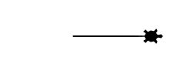
Tracy Command: forward
forward(distance)
Moves Tracy forward a specified distance
forward(100)
Notes:
The first command we’re going to learn is the forward command. In order for Tracy to understand this command, we need to write the word ‘forward’ in all lowercase letters, and then next to it in parentheses, we need to put a number. This is how far we want Tracy to move.
If we use an uppercase letter or we forget our parentheses, we are no longer speaking to Tracy in the language she understands so she will not know what to do and we will get an error. We need to make sure that we are always communicating with Tracy in the exact form, or syntax, that she understands. Let’s look at this command in our code editor.

Slide 4
CODE EDITOR- Introduction
Make sure you have Python 3.7 installed!!
You can use either Idle, notepad++ or visual code for coding with python.
Notes:
This is our code editor. You’re going to be using it to write all of your programs in this course so let me give you a quick tour. On the left side of the screen, you have this large white space. That’s where the magic happens. You write your code in here and when you click this ‘Run Code’ button, all the commands you have typed will run and the output will be shown in this box here. Okay, let’s write some code.
If I tell Tracy forward(100), and run this code, **, Tracy moves forward 100 pixels.
If I tell Tracy forward(50), she should move half as far. ** And she does!
Also notice that every time I press the ‘run code’ button, Tracy returns back to her starting point in the middle of our canvas.
What do we think will happen if we try to use the forward command without parentheses. ** Well, Tracy will give us an error because we’re no longer speaking to her in correct Python syntax.

Slide 5
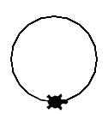
Tracy Command: circle
circle(radius)
Tells Tracy to draw a circle with a specified radius
50
circle(50)
Notes:
We’ve seen how to move Tracy forward but let’s learn one more command that Tracy knows. The circle command will tell Tracy to draw a circle with a certain radius value. (Click for red line and label) The radius of a circle is the distance from the center to the circle’s edge. Let’s put these commands together to solve a coding challenge.

Slide 6
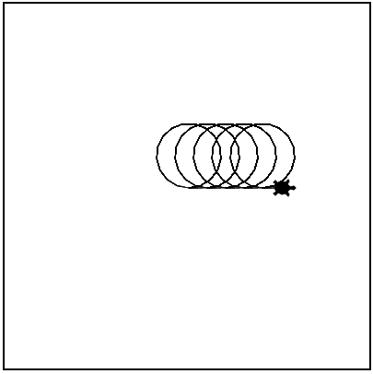
Example #1: Slinky
Write a program that has Tracy draw a slinky with 5 loops.
Notes:
In our first program we’re going to use the circle command to draw a slinky.

Slide 7
Commands Learned this Lesson
Command | What does it do?
forward(distance) | Moves Tracy forward a specified distance
circle(radius) | Tells Tracy to draw a circle with a specified radius
Notes:
In this lesson, we learned how to communicate with Tracy using the forward and circle commands. Now it’s your turn to use these commands to write your first Tracy program!

